Slide 1

Kronisk nyresygdom
Johan V Povlsen, Nyresygdomme, AUH

Slide 2
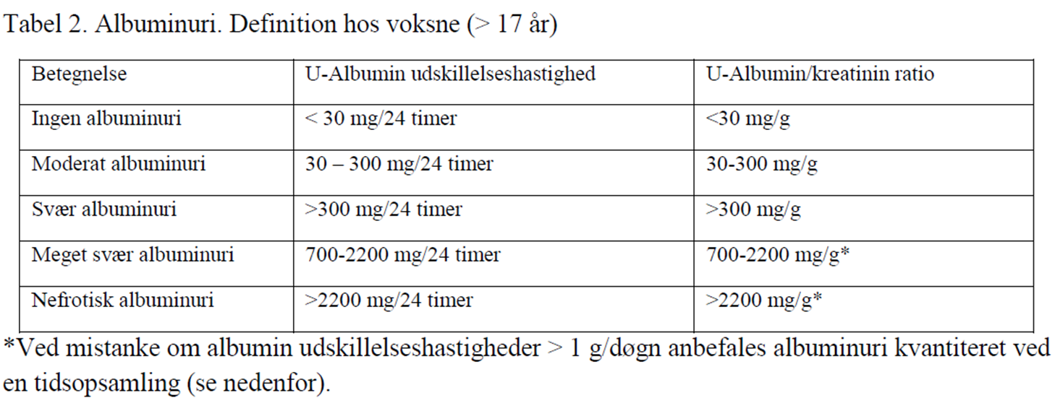
Klassifikation af albuminuri

Slide 3
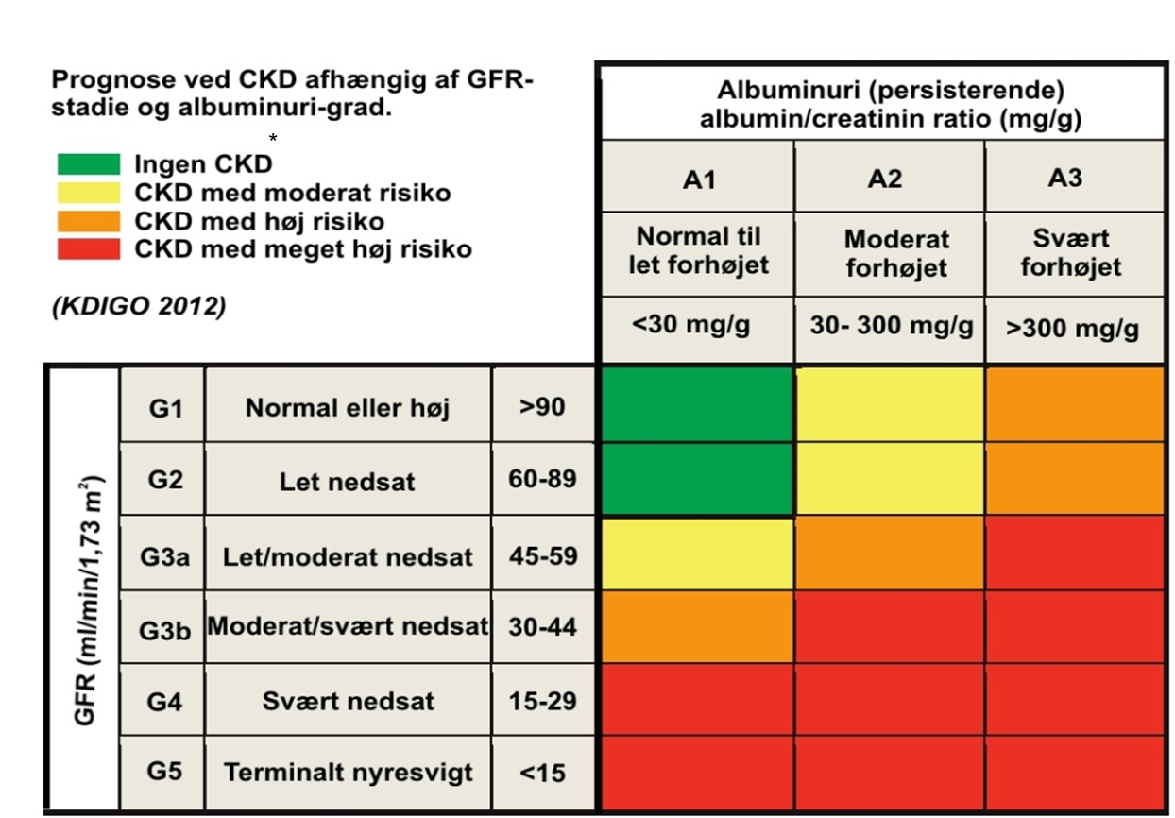
CKD-klassifikation

Slide 4
CKD in T2D: a growing disease population with a complex prognosis
2017: 425 million people
One in 11 adults had diabetes
Prognosis of patient with T2D and dialysis¹
Prostate cancer
Thyroid cancer
48% increase
Breast cancer
Hodgkin lymphoma
Bladder cancer
Non-Hodgkin lymphoma
Kidney cancer
Colorectal cancer
Leukaemia
Long-term dialysis
Myeloma
2045: 629 million people
will have diabetes¹
Dialysis + T2D
Heart failure
Stomach cancer
Oesophageal cancer
Lung cancer
Pancreatic cancer
0
20
40
60
80
100
% 5-year survival
CKD occurs in approximately 40% of adults with T2D, and represents a huge burden in this population
CKD, chronic kidney disease; T2D, type 2 diabetes. 1. International Diabetes Federation. IDF Diabetes Atlas. 8th edn. Brussels, Belgium: IDF, 2017. Available at: http://www.diabetesatlas.org; accessed 12 Apr 2019
Presented at the 56th European Renal Association - European Dialysis and Transplant Association (ERA-EDTA) Congress, 13–16 June 2019, Budapest, Hungary

Slide 5
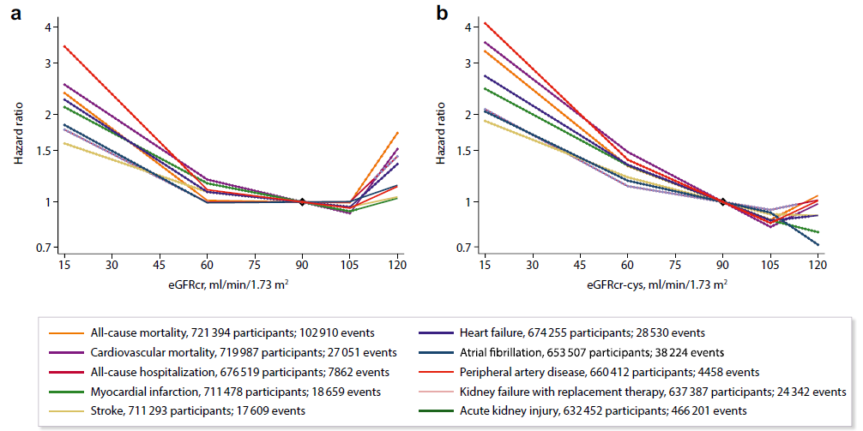
www.kidney-international.org

Slide 6
Clinical trials in chronic kidney disease
DKD
ACE inhibitor
ARB
Clinical trial
Lisonopril^{2,a}
CREDENCE¹⁰
ERA
RENAAL⁶
SGLT2 inhibitor
SONAR⁹
FLOW
Clinical trial
Captopril¹
MICRO-HOPE⁴
MRA
FIDELIO-DKD¹²
GLP1-RA
IDNT⁶
FIGARO-DKD
1990
1994
1998
2002
2006
2010
2014
2018
2022
2024
NDKD
DAPA-CKD¹¹
ACE inhibitor
EMPA-KIDNEY
ERA
SGLT2 inhibitor

Slide 7
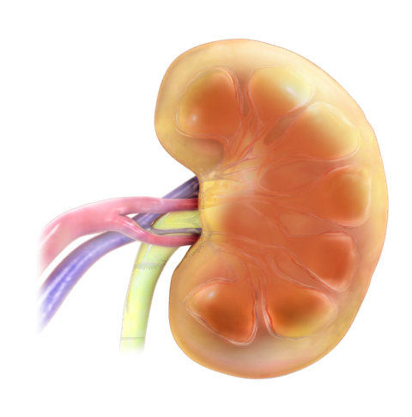
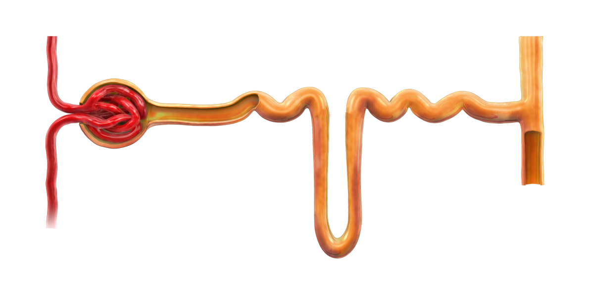



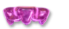
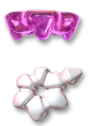



SGLT-2 hæmmere
Det meste af glukosen reabsorberes af SGLT2 (90%)
Proximal tubulus
SGLT2
Overskydende glukose reabsorberes af SGLT1 (10%)
Glukose
Minimal til ingen glukoseekskretion
Glukose-
filtration
SGLT, sodium-glucose co-transporter.
Wright EM. Am J Physiol Renal Physiol 2001;280:F10–18 og Bailey and Day; SGLT2 inhibitors: glucoretic treatment for type 2 diabetes.Br J Diabetes Vasc Dis 2012;10:193-99.

Slide 8
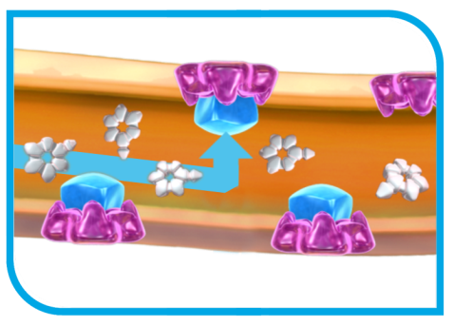




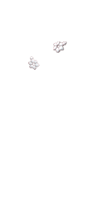


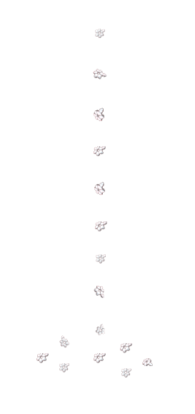


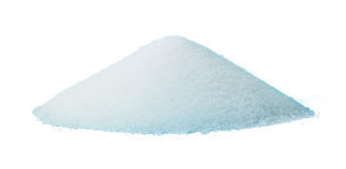
SGLT2 hæmning: Insulinuafhængig mekanisme, der fjerner overskydende glukose via urinen
SGLT2
Forxiga
Proximal tubulus
SGLT2-i
SGLT2
Glukose-
filtration
Øget glukosuri grundet overskydende glukose (~70 g/dag, eller 280 kcal/dag*)
Glukose
SGLT2-hæmmere hæmmer selektivt SGLT2 i de proximale tubuli
*Increases urinary volume by only ~1 additional void/day (~375 mL/day) in a 12-week study of healthy subjects and patients with Type 2 diabetes.
SGLT2 inhibitors: glucuretic treatment for type 2 diabetes; Diabetes Met;2010;193-9 og Forxiga produktresume

Slide 9
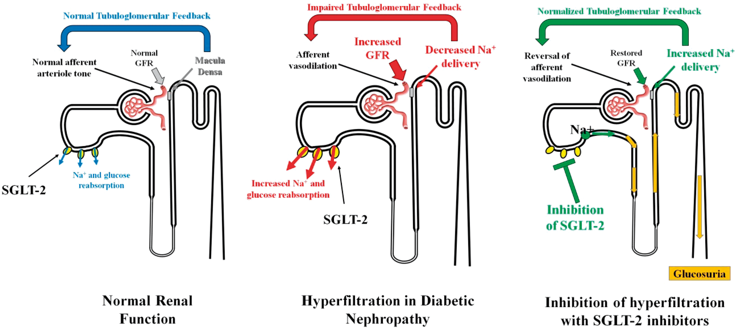

FIGURE 2: Actions of SGLT-2 inhibitors on the renal microcirculation in patients with DM. Under physiological ...
Notes:
FIGURE 2: Actions of SGLT-2 inhibitors on the renal microcirculation in patients with DM. Under physiological conditions, SGLT-2 co-transporters reabsorb around 90% of the filtered glucose and relevant amounts of sodium, the macula densa is orchestrating normal tubulo-glomerular feedback and GFR is normal. In patients with DM, the number and activity of SGLT-2 co-trasporters are increased, thus the macula densa senses relatively lower sodium and chloride concentrations, leading to afferent arteriole vasodilation and hyperfiltration. Inhibition of SGLT-2 blocks proximal tubule glucose and sodium reabsorption, which leads to increased sodium and chloride delivery to the macula densa, restoration of normal tubulo-glomerular feedback and afferent vasoconstriction, which in turn reduces renal plasma flow and GFR.
Unless provided in the caption above, the following copyright applies to the content of this slide: © The Author(s) 2019. Published by Oxford University Press on behalf of ERA-EDTA. All rights reserved.This article is published and distributed under the terms of the Oxford University Press, Standard Journals Publication Model (https://academic.oup.com/journals/pages/open_access/funder_policies/chorus/standard_publication_model)

Slide 10
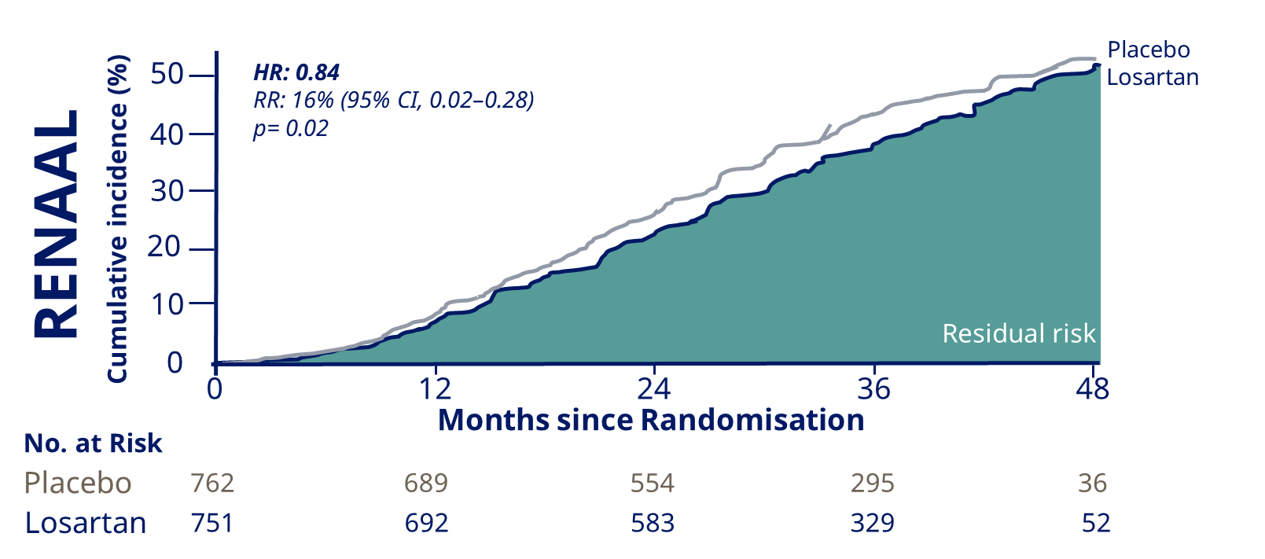
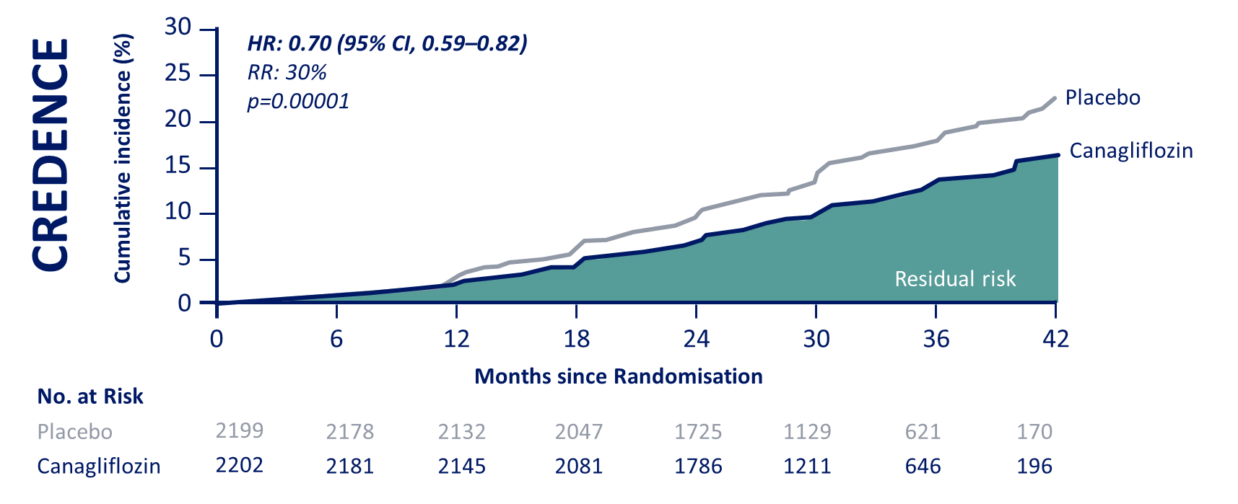
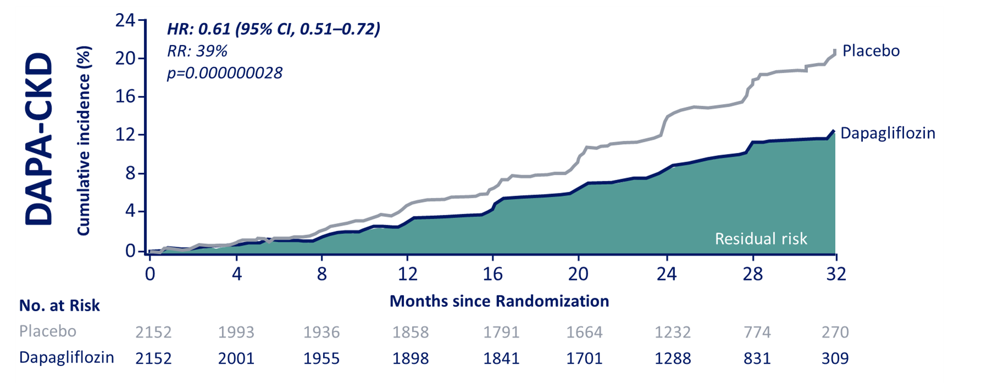
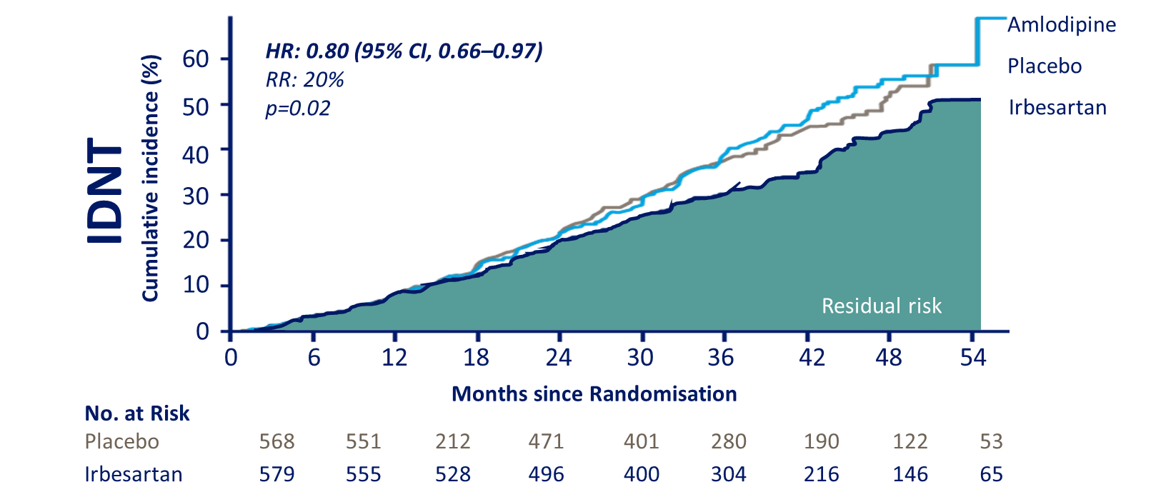
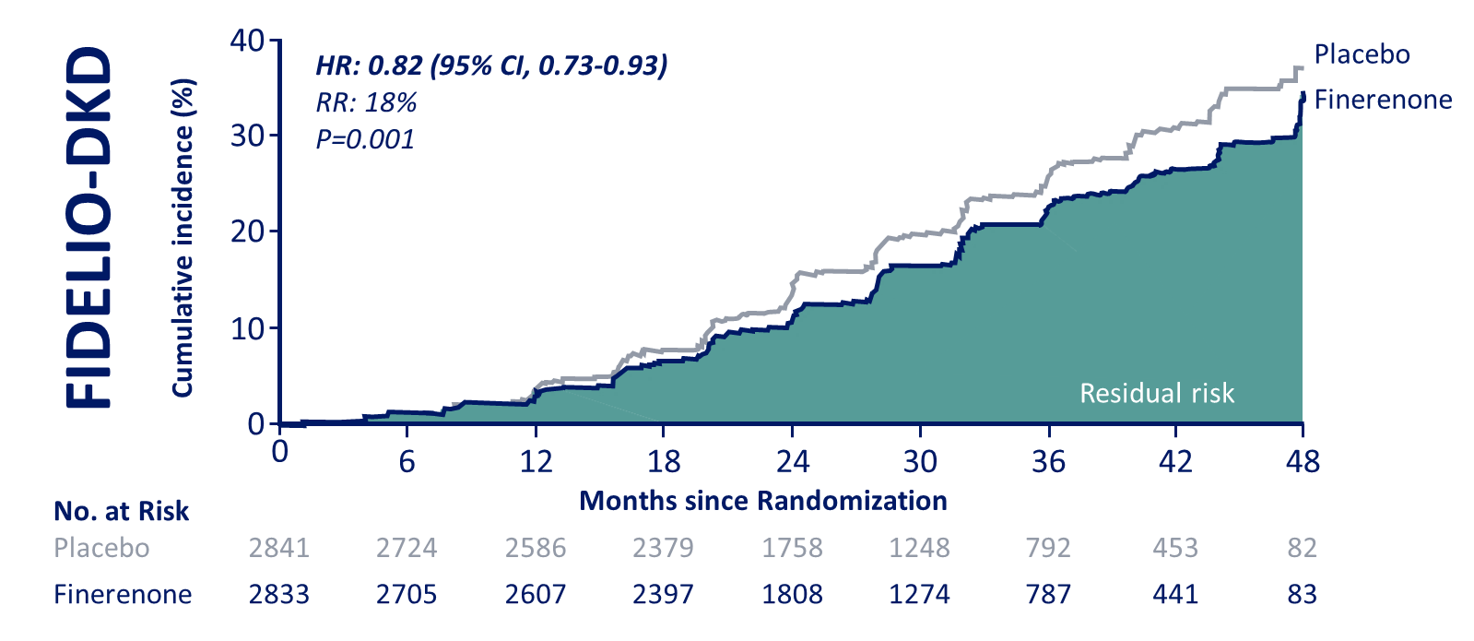
Progression of renal disease;
Treatment has improved, but…
Bakris G et al. N Engl J Med 2020; Brenner BM et al. N Engl J Med 2001; Heerspink H et al. N Engl J Med 2020; Perkovic V et al. N Engl J Med 2019; Lewis EJ et al. N Engl J Med 2001

Slide 11
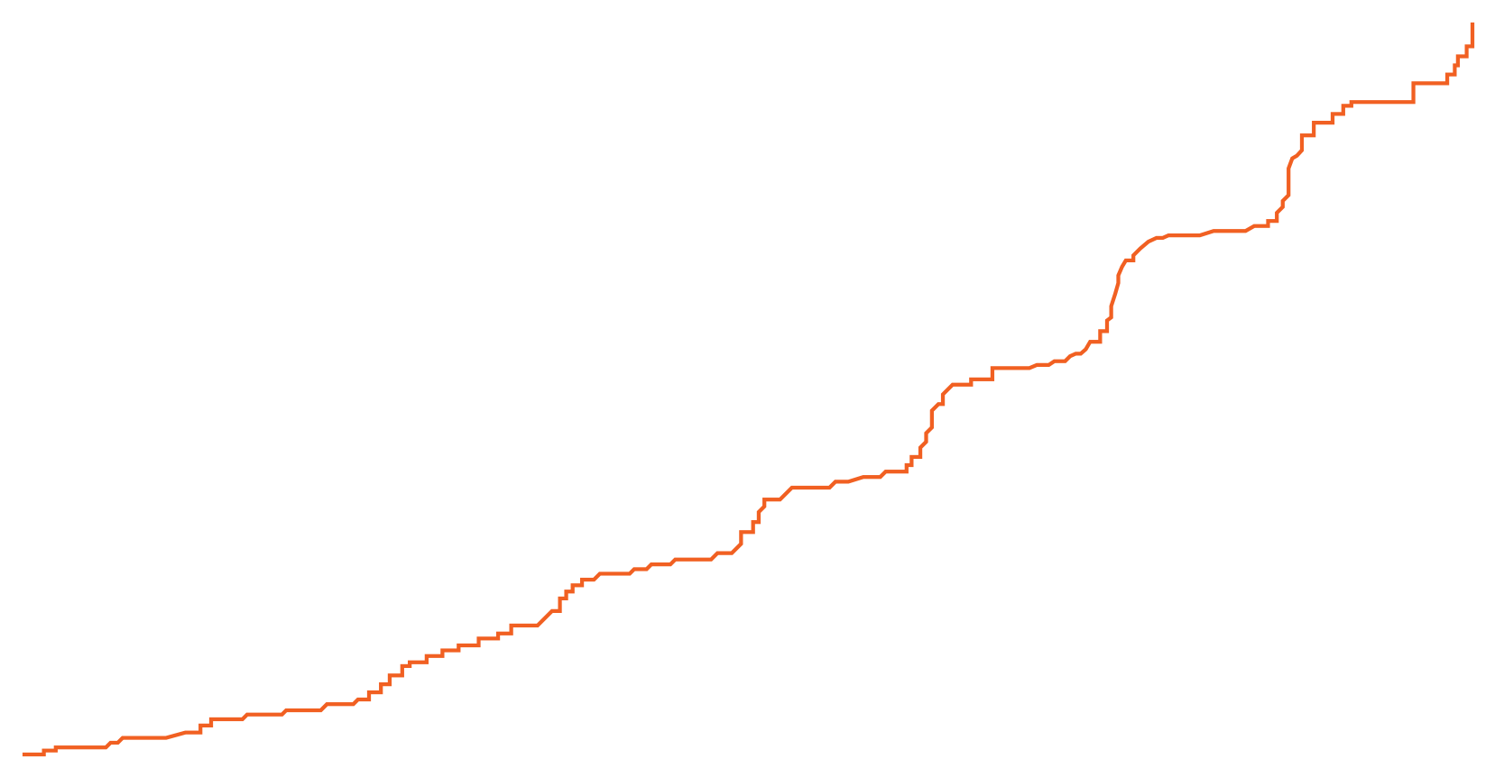
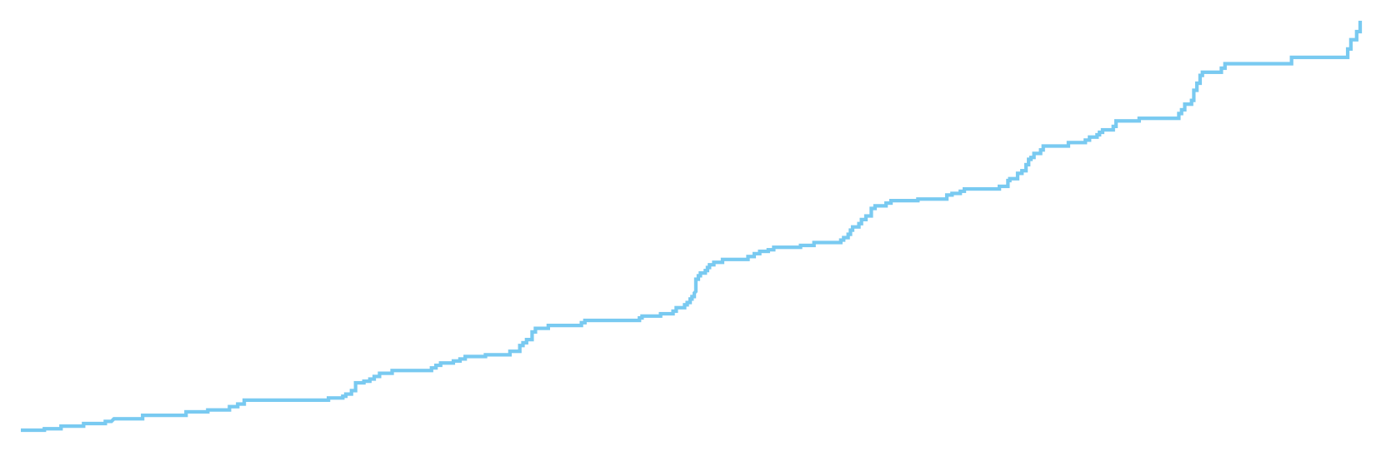
Primary outcome:
Sustained ≥50% eGFR decline, ESKD, renal or cardiovascular death
Hazard ratio, 0.61 (95% CI, 0.51–0.72)
p=0.000000028
NNT=19
312 Events
Placebo
197 Events
Dapagliflozin
Heerspink HJL. et.al. Presented at ESC 2020.

Slide 12
Secondary outcome:
Sustained ≥50% eGFR decline, ESKD, renal death
Heerspink HJL. et.al. Presented at ESC 2020.

Slide 13
Chronic dialysis, kidney transplantation, renal death
Heerspink HJL. et.al. Presented at ESC 2020.

Slide 14
Secondary outcome:
All-cause mortality
Heerspink HJL. et.al. Presented at ESC 2020.

Slide 15
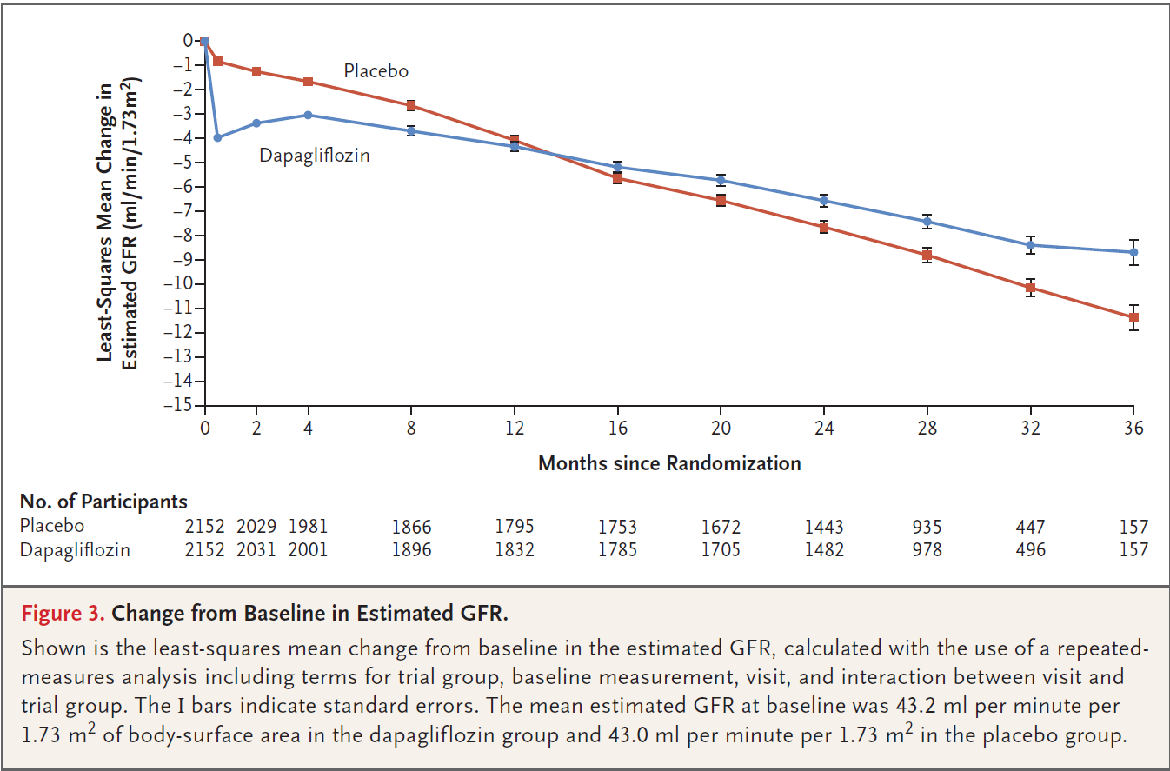
Ændringer i eGFR
Dapagliflozin vs placebo
Heerspink HJL. et.al. Presented at ESC 2020.

Slide 16
Ændringer i eGFR
Dapagliflozin vs placebo
Start ikke SGLT2i
Ved
eGFR < 20 ml/min
Det er ikke
nødvendigt at
kontrollere eGFR
efter start
Heerspink HJL. et.al. Presented at ESC 2020.

Slide 17
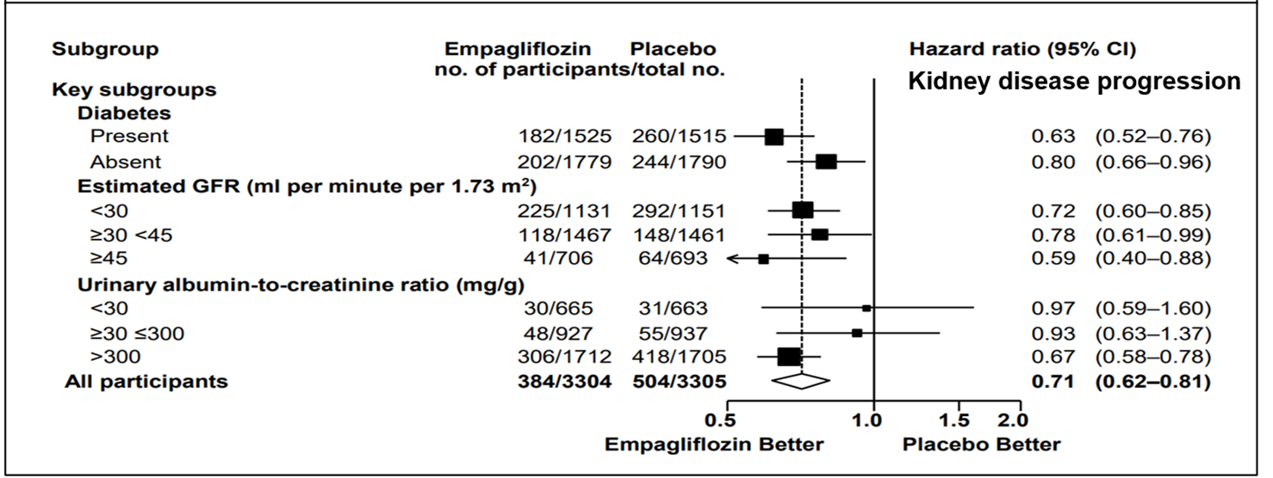
Pre-specified sub-groups:

Slide 18
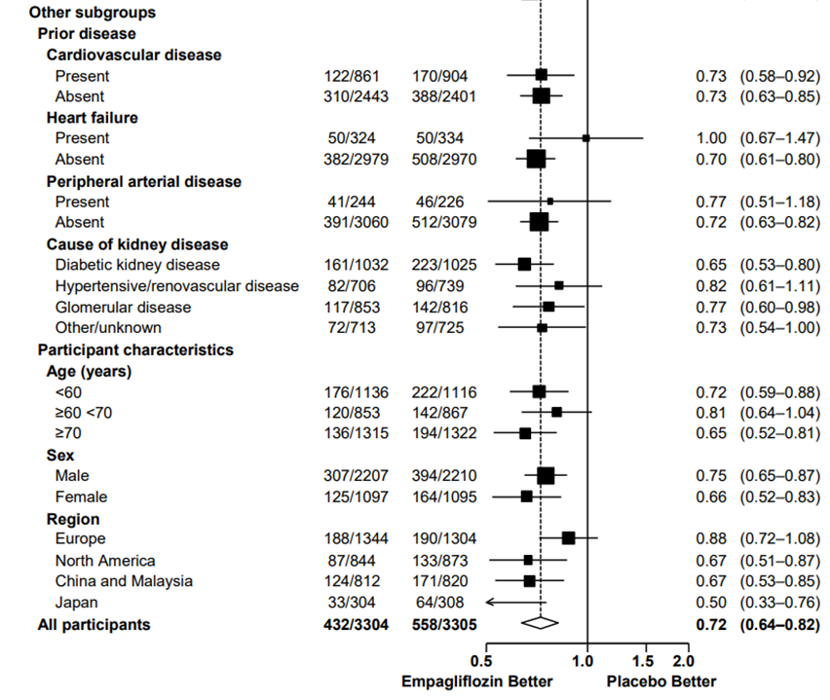
Other subgroups

Slide 19
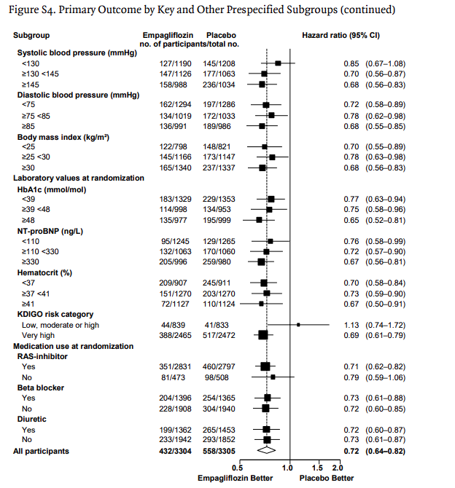
Other subgroups

Slide 20
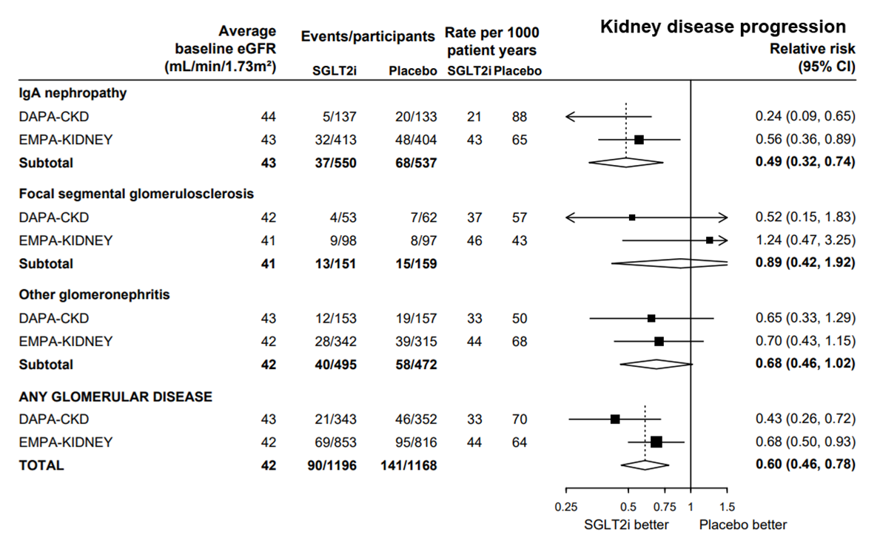
Other subgroups: CKD

Slide 21
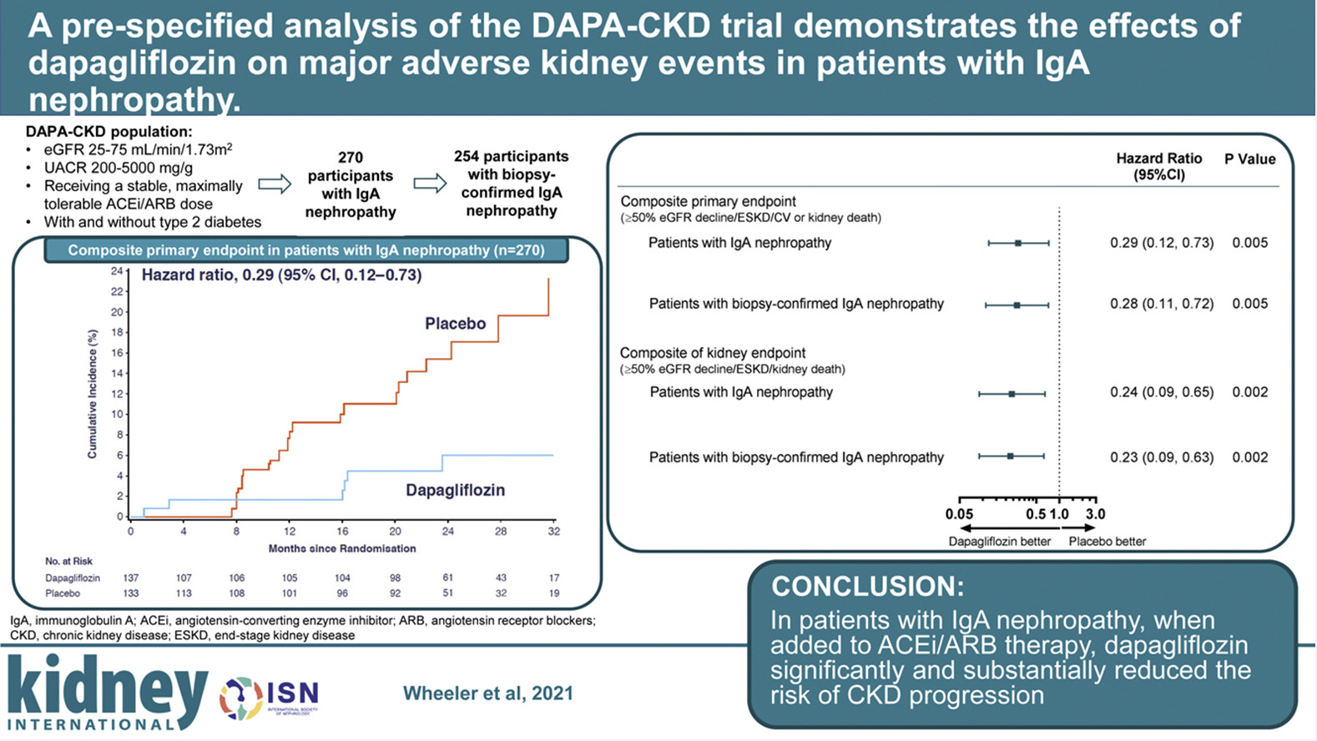

Slide 22
Nefrologens anbefaling I: SGLT2 hæmmer
DM2 og nyresygdom: Alle med eGFR > 20 ml/min uanset UACR
CKD: Alle med eGFR > 20 ml/min og UACR > 200 mg/l
Dog: ?????????
HUSK: Antiglykæmisk effekt aftager ved eGFR = 60 ml/min og forsvinder ved ca. 30-45 ml/min, men
                SGLT2I skal fortsættes.

Slide 23
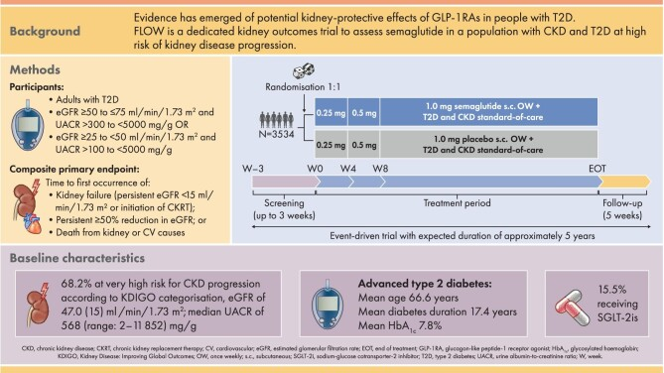

Slide 24
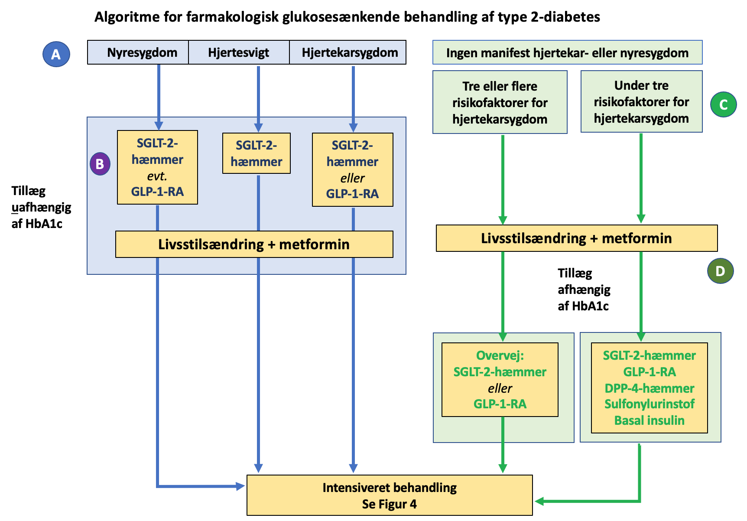

Slide 25
DM2: Farmakologisk behandling af BT og albuminuri
Behandlingsmål: 130/80
ACEi eller ARB er førstevalg
SGLT2i uafhængig af UACR
Overvej GLP1-RA
Overvej Finerenone (Kerendia)
Progressionshæmning vigtigere end HbA1c

Slide 26
